Slide 1

FUNCTIONALITY
Of
BLOCKCHAIN

Slide 2
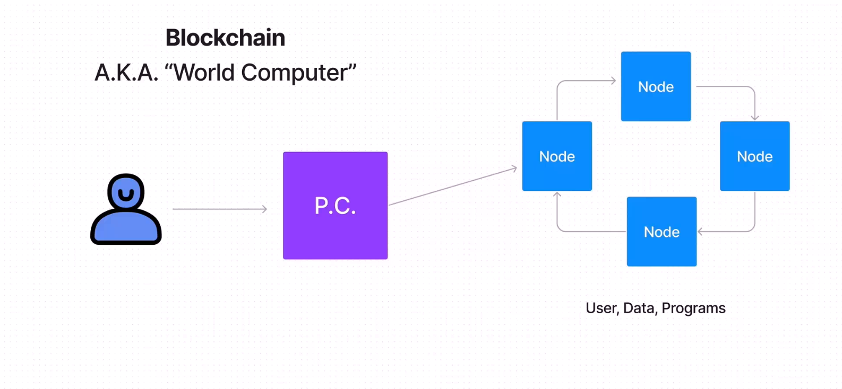

Slide 3
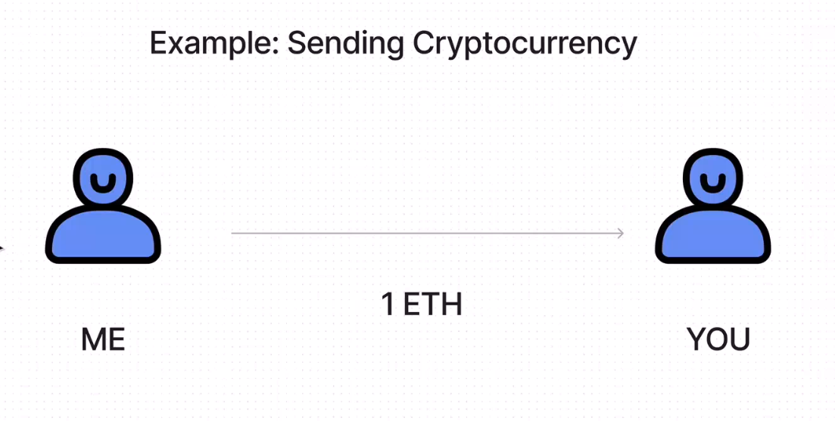

Slide 4
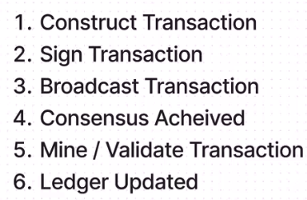

Slide 5
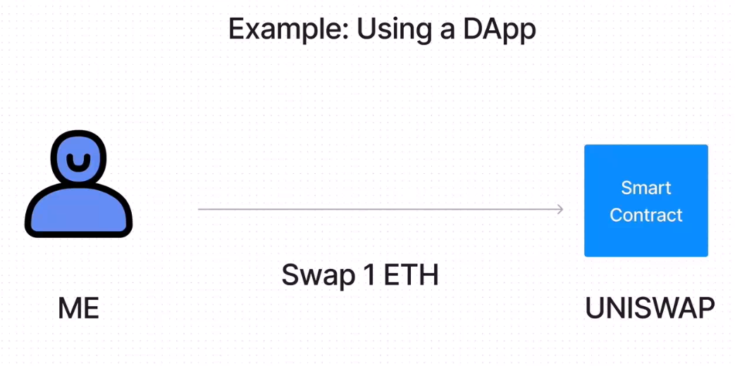

Slide 7

Block in Blockchain
Data : "Something"
Previous Hash : 759831720aa
Hash: : 7598317204P

Slide 8

Block in Blockchain
Genesis Block
Data : ...................
Previous Hash : 0000000000
Hash: : 7598317204P
Data : ....................
Previous Hash : 7598317204P
Hash: : 752edfy204P
Data : ....................
Previous Hash : 752edfy204P
Hash: : 9wueEE334e

